Slide 1

Differentiable programming for modeling and control of dynamical systems
Invited Talk at COEP Tech University, Pune
Ján Drgoňa Collaborators: Aaron Tuor, Shrirang Abhyankar, Ethan King, James Koch, Zhao Chen, Soumya Vasisht, Vikas Chandan, Wenceslao Shaw Cortez, Sayak Mukherjee, Mahantesh Halappanavar, Draguna Vrabie

Slide 2

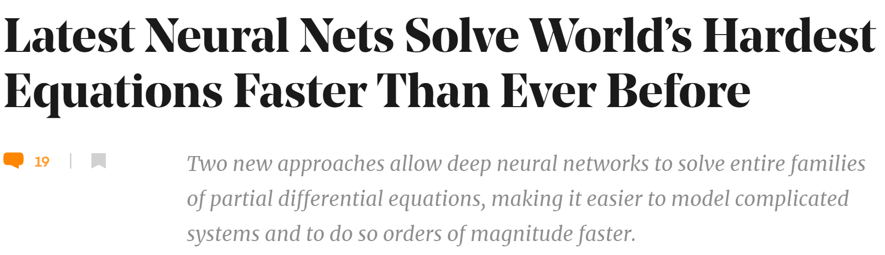

Challenge 1: Systems Modeling
Simulations are crucial for many areas of decision-making and scientific discovery
Need: Improve computational efficiency and scalability for heterogenous scientific simulations
Approach: Integration of machine learning with physics-based models
Applications: building energy systems, power systems, molecular dynamics, unmanned vehicles

Slide 3
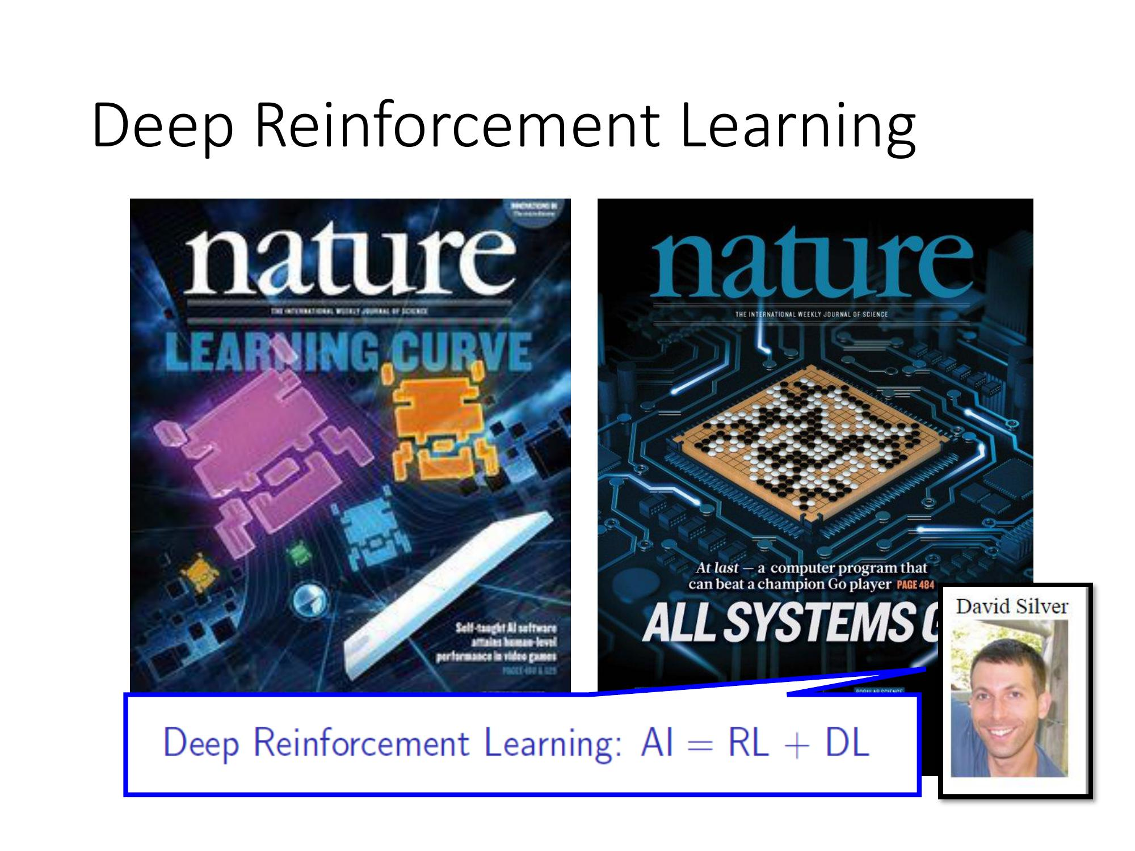

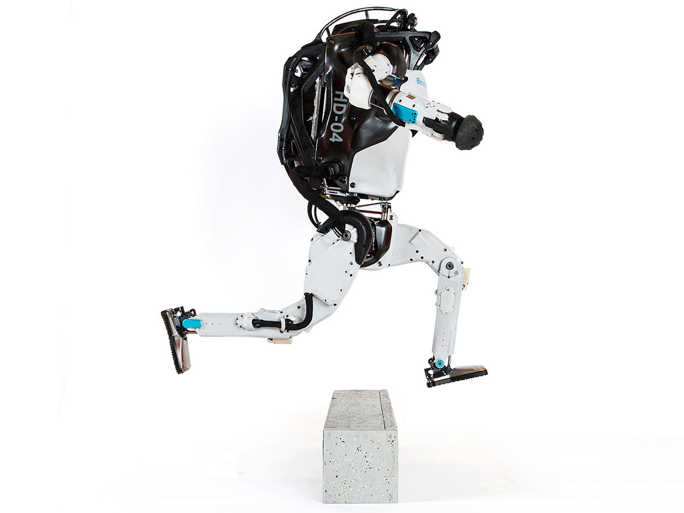
Challenge 2: Systems Control
Model Predictive Control
Reinforcement Learning
95% of the industrial control applications are PID loops & expert driven rule-based control (RBC).
The rest is model predictive control (MPC).
Everywhere where you have reliable digital environment model, mostly discrete action space, and you can use massive compute to solve the problem.
Drgona J., J. Arroyo, I.C. Figueroa, D. Blum, K. Arendt, D. Kim, and E.P. Olle, J. Oravec, M. Wetter, D. L. Vrabie, L. Helsen. 2020. "All You Need to Know About Model Predictive Control for Buildings." Annual Reviews in Control, September 29, 2020
G. Dulac-Arnold, D. J. Mankowitz, and T. Hester, “Challenges of real-world reinforcement learning,”, 2019. http://arxiv.org/abs/1904.12901

Slide 4

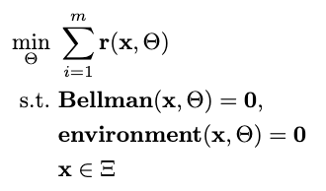

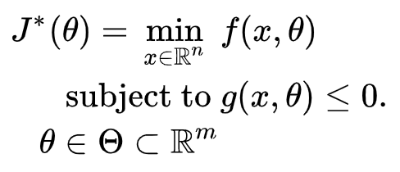

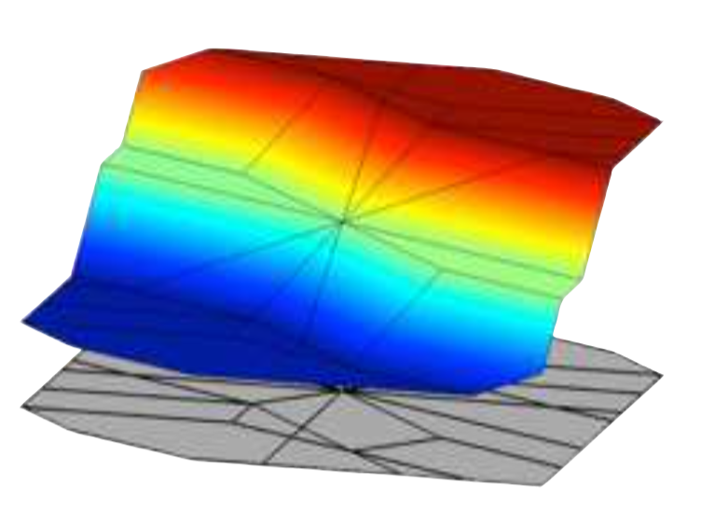
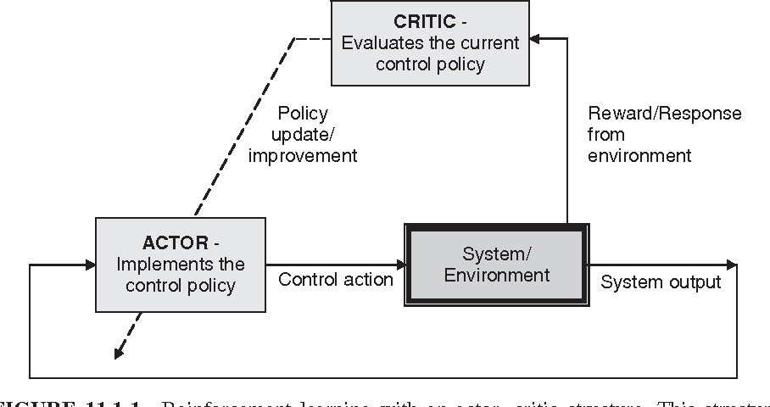

Landscape of Optimization Methods
Online optimization
Parametric programming
Imitation Learning
Reinforcement Learning
“online” solution for given parameter values
computationally demanding in real-time
“offline” optimization obtains a solution map
classical methods lead to exponential complexity!
“offline” optimization
obtains a model (map)
scalable but requires expert controller
“offline” optimization
obtains a policy map
classically can’t handle constraints

Slide 5
Landscape of Optimization Methods
Online optimization
Parametric programming
Imitation Learning
Reinforcement Learning
“online” solution for given parameter values
computationally demanding in real-time
“offline” optimization obtains a solution map
classical methods lead to exponential complexity!
“offline” optimization
obtains a model (map)
scalable but requires expert controller
“offline” optimization
obtains a policy map
classically can’t handle constraints
Differentiable programming (DP): a unifying approach for data-driven parametric optimization with solutions based on automatic differentiation (AD)

Slide 6
Differentiable Programming for Scientific Machine Learning
Differentiable Programming
A Differentiable Programming System to Bridge Machine Learning and Scientific Computing, 2019
Physics-informed Neural Networks
Physics-informed neural networks: A deep learning framework for solving forward and inverse problems involving nonlinear partial differential equations, 2019
Neural Differential Equations
Neural Ordinary Differential Equations, 2019
Universal Differential Equations for Scientific Machine Learning, 2021
Differentiable Optimization
Differentiable Convex Optimization Layers, 2019
DC3: A learning method for optimization with hard constraints, 2021
Deep Declarative Networks: A New Hope, 2020
End-to-End Constrained Optimization Learning: A Survey, 2021
Differentiable Control
Differentiable MPC for End-to-end Planning and Control, 2019
Infinite-Horizon Differentiable Model Predictive Control, 2020

Slide 7
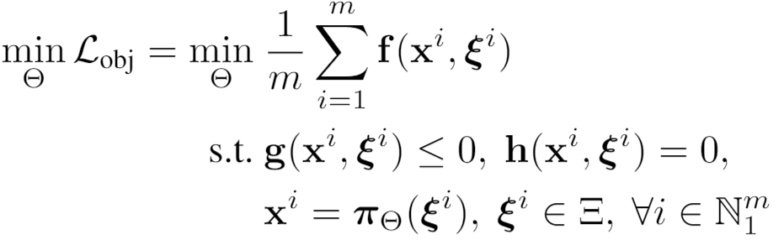
Parametric Optimization via Differentiable Programming: Generalization of PINNs
Problem formulation:

Slide 8
Parametric Optimization via Differentiable Programming: Generalization of PINNs
Objective function
Problem formulation:
Constraints
Primal optimizers
Scenarios
Solution map
Parameters

Slide 9
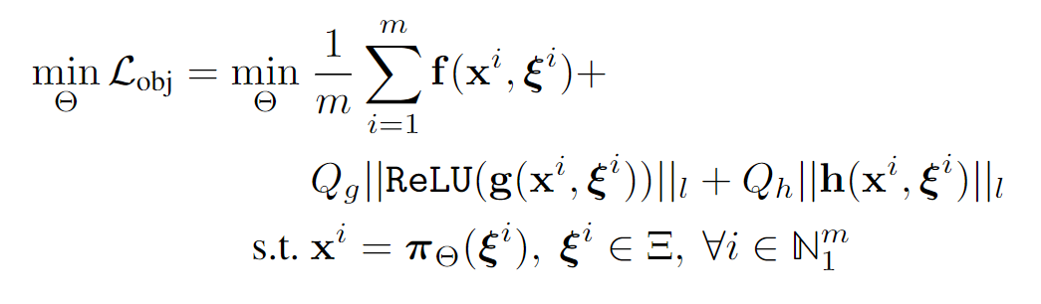
Parametric Optimization via Differentiable Programming: Generalization of PINNs
Objective function
Problem formulation:
Constraints
Primal optimizers
Scenarios
Solution map
Parameters
Lagrangian form:
Constraints penalties
Gradient-based optimization based on AD

Slide 10

Differentiable Parametric Programming: NeuroMANCER toolbox
train_data, dev_data, test_data = get_dataloaders(samples)
p = Variable(‘p’) # sampled parameter
x = Variable(‘x’) # decision variable
y = Variable('y’) # decision variable
map = nm.MLP(input_keys=['p’], output_keys=[‘x’,‘y’], name='map’)
# parametric solution map
f = x ** 2 + y ** 2 obj = f.minimize(weight=Q, name='obj’) # objective function con_1 = Q_con*(-x - y + p <= 0) # constraint
con_2 = Q_con*(-x + y + p <= 0) # constraint
objectives = [obj]
constraints = [con_1, con_2] components = [map]
loss = PenaltyLoss(objectives, constraints, train_data) problem = Problem(components, loss) # differentiable optimization optimizer = torch.optim.AdamW(problem.parameters(), lr=args.lr) trainer = Trainer(problem,train_data,dev_data,test_data,optimizer)
best_model = trainer.train()
Neural Modules with Adaptive Nonlinear Constraints and Efficient Regularizations
https://github.com/pnnl/neuromancer

Slide 11
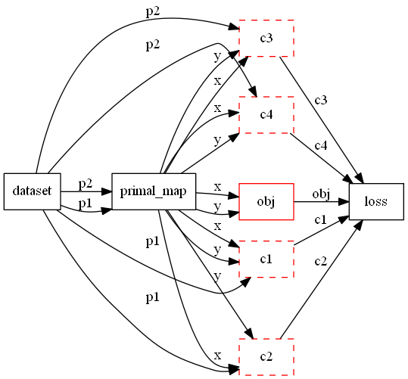
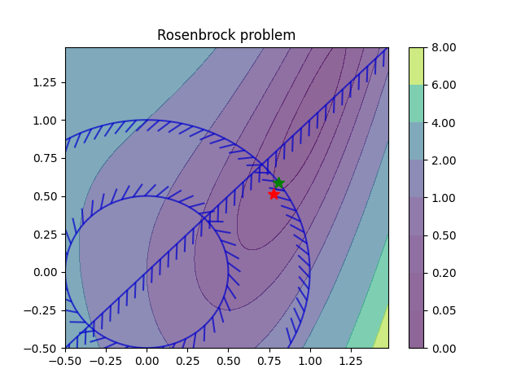
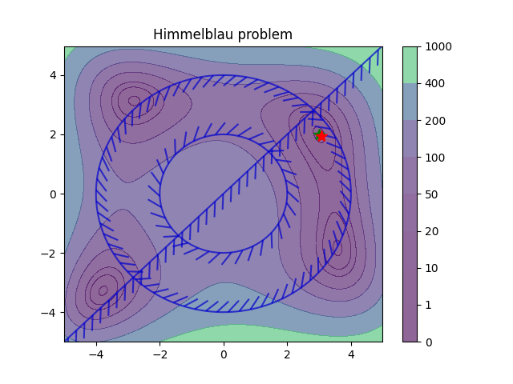
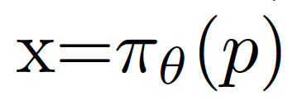
Differentiable Parametric Programming: Computational Graphs
Parametric nonlinear programs
Orders of magnitude faster online solution compared to online optimization solvers (IPOPT).

Slide 12
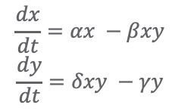
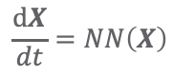
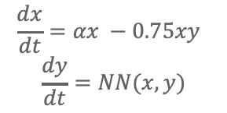
Universal Differential Equations
Methods:
Learning flow maps (MLPs and RNNs) for neural ODE implicit layers
ODE solution techniques: RK45, hierarchical, higher-order, implicit, multi-step
Physically-informed models: blend expert knowledge with neural ODE construction
Graph structured neural ODEs
White-box:
Gray-box:
Black Box:
$$\frac{dx}{dt}=αx −βxy$$
$$\frac{dy}{dt}=δxy −γy$$
$$\frac{dx}{dt}=αx −0.75xy$$
$$\frac{dy}{dt}=NN(x,y)$$
$$\frac{dX}{dt}=NN\left(X\right)$$
Christopher Rackauckas, et al., Neural Ordinary Differential Equations, arXiv:2001.04385, 2019 James Koch, et al., Structural Inference of Networked Dynamical Systems with Universal Differential Equations, arXiv:2207.04962, 2022

Slide 13
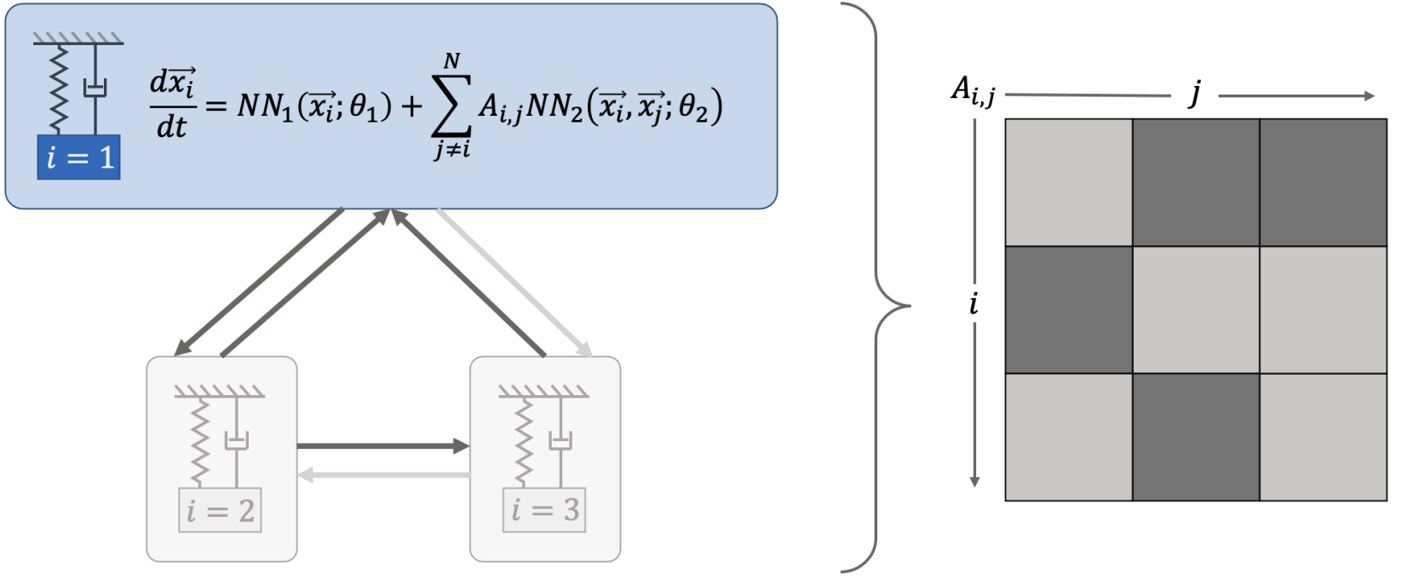
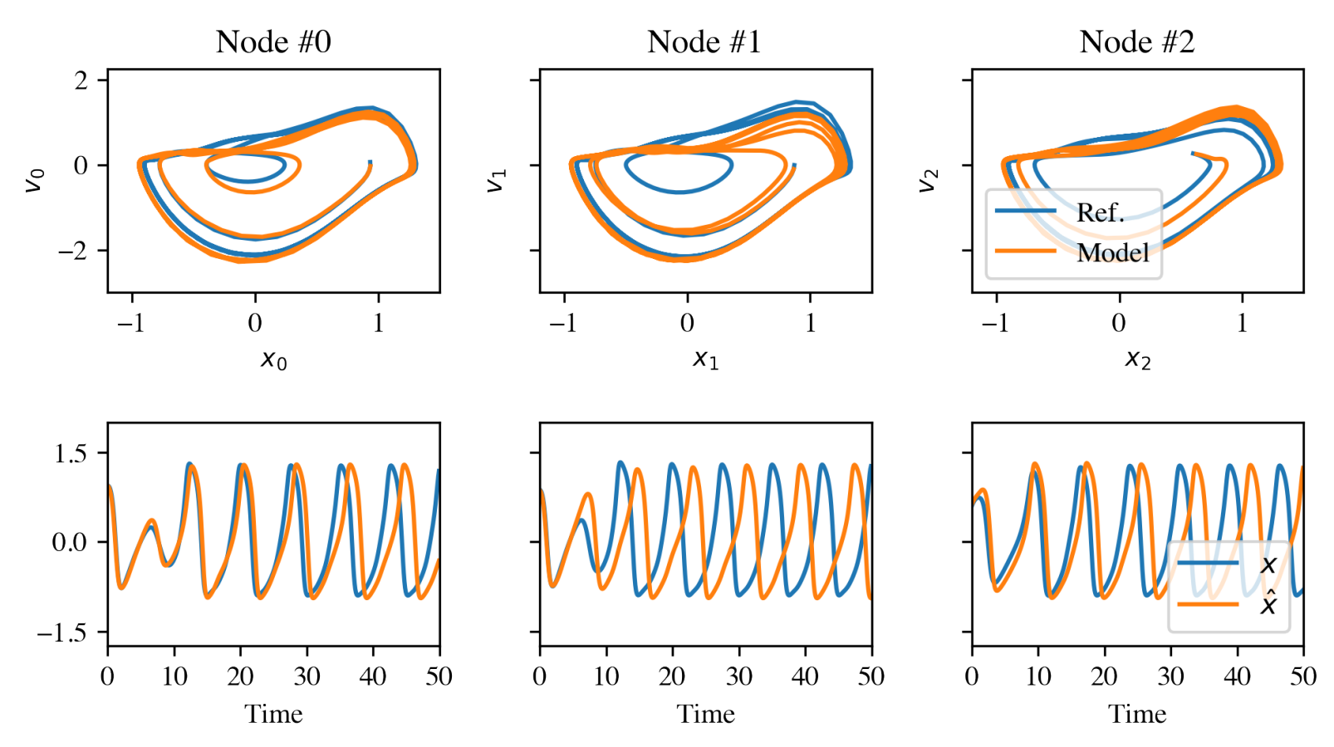
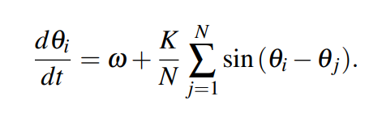
Networked Dynamical Systems via Universal Differential Equations
Network of unknown oscillators
Coupling adjacency
Qualitative generalization of learned dynamics on never-seen network topology.
Ground truth Kuramoto system:
Christopher Rackauckas, et al., Neural Ordinary Differential Equations, arXiv:2001.04385, 2019 James Koch, et al., Structural Inference of Networked Dynamical Systems with Universal Differential Equations, arXiv:2207.04962, 2022

Slide 14
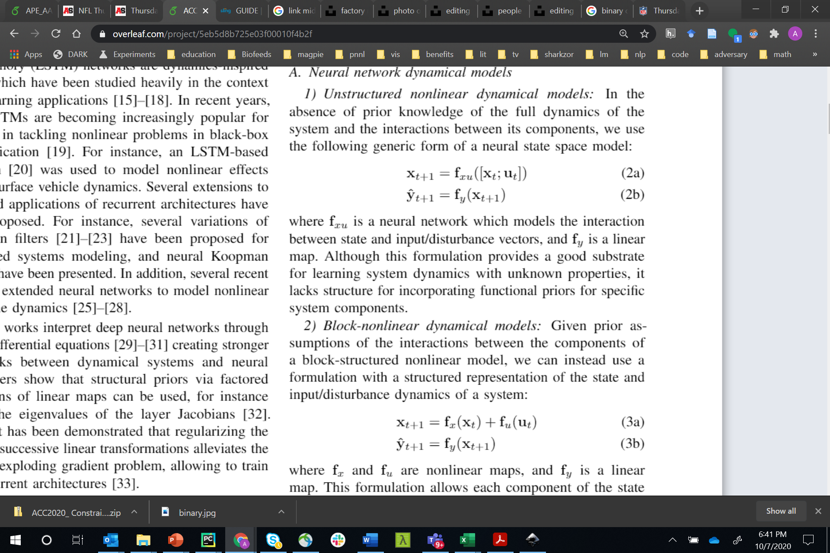
Neural State Space Models
x_{t}
f_{x}
x_{t+1}
f_{y}
x₀
+
y_{t+1}
f_{x}
f_{y}
f_{u}
f_{x}
f_{y}
+
u_{t}
f_{u}
f_{u}
f_{u} o f_{y} = I
Linear
Hammerstein
Koopman
x_{t}
x_{t+1}
y_{t+1}
f_{x}
f_{y}
f_{x}
f_{y}
f_{xu}
f_{y}
+
+
u_{t}
f_{u}
f_{u}
Block-Nonlinear
Unstructured
Hammerstein-Weiner
Linear map
Non-Linear map

Slide 15
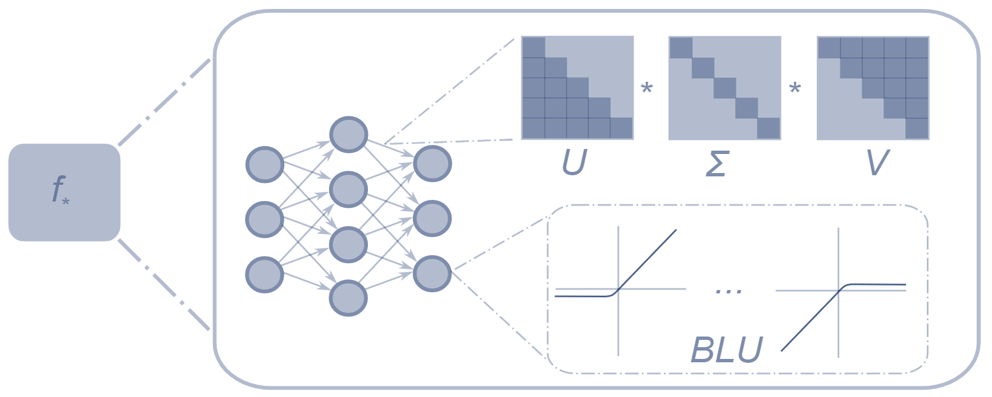
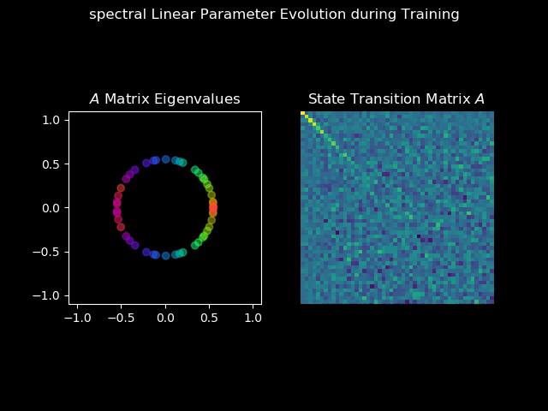
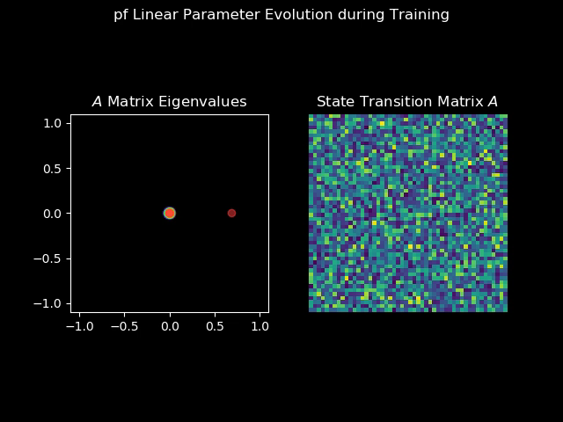
Structured Linear Maps (SLiM)
Factorizations and regularizations of linear maps with predetermined structure
Can be used to enforce sparsity or spectral properties
https://github.com/pnnl/slim
Spectral map
Perron-Frobenius map

Slide 16
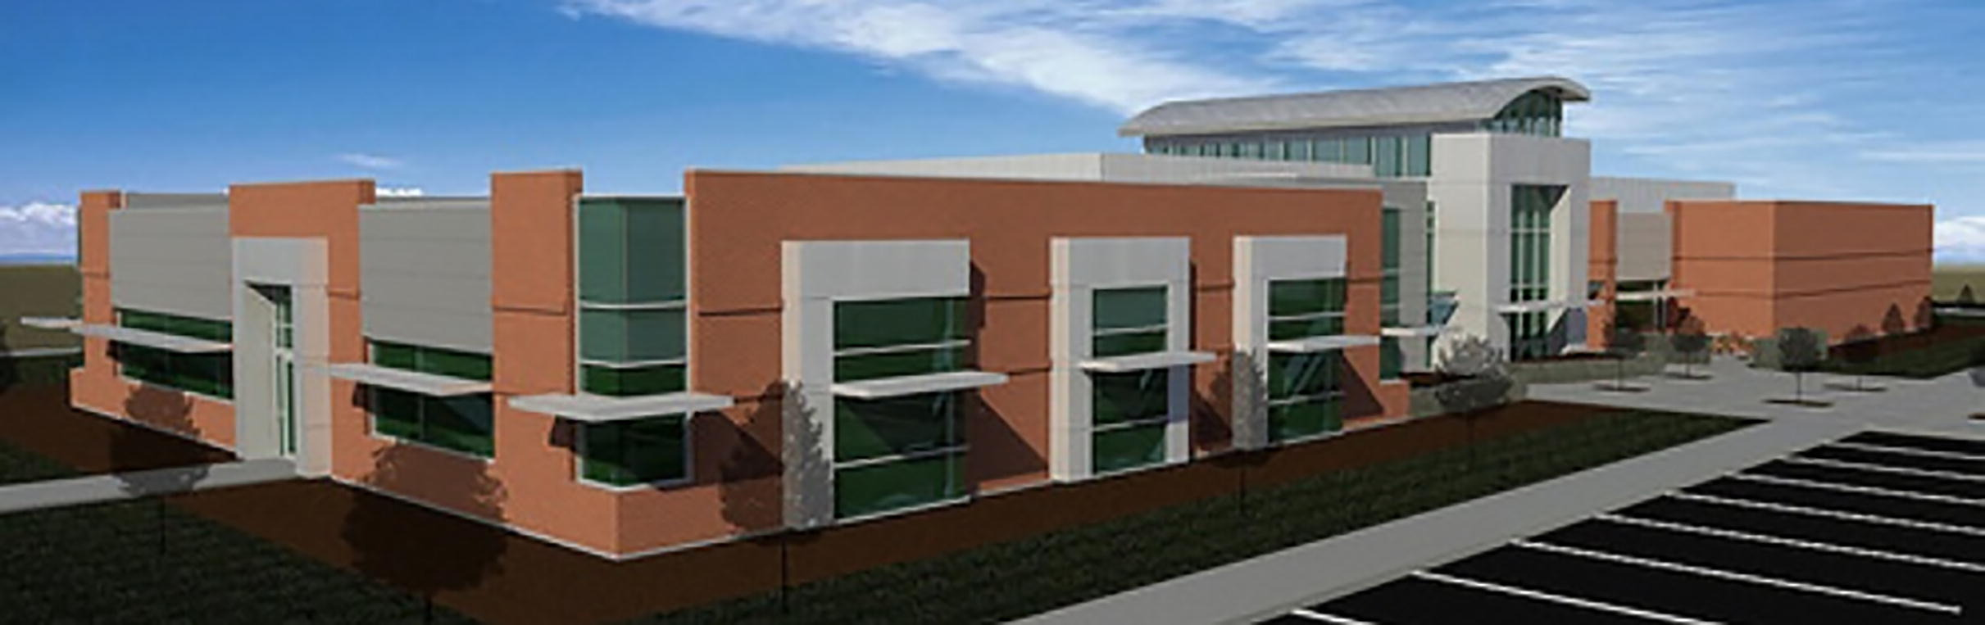
Application: Modeling Thermal Dynamics
Ján Drgona, et al., Physics-constrained deep learning of multi-zone building thermal dynamics, Energy and Buildings, 2021

Slide 17
Modeling Thermal Dynamics
Ján Drgona, et al., Physics-constrained deep learning of multi-zone building thermal dynamics, Energy and Buildings, 2021

Slide 18
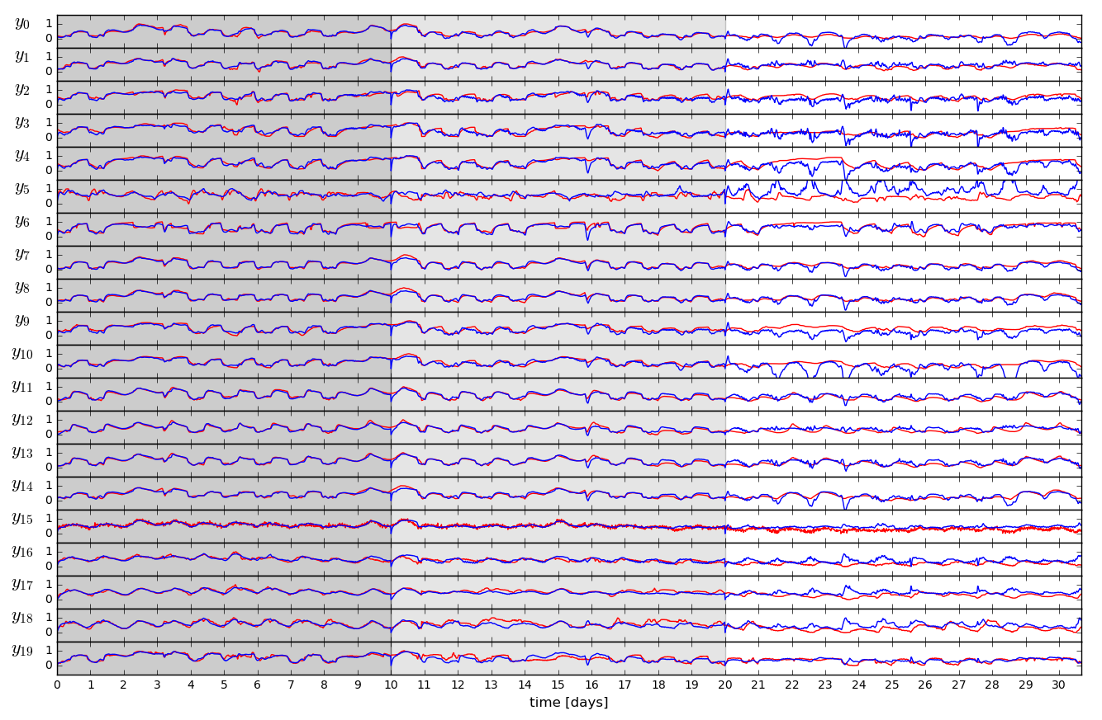
Open-loop Trajectories of Linear Model

Slide 19
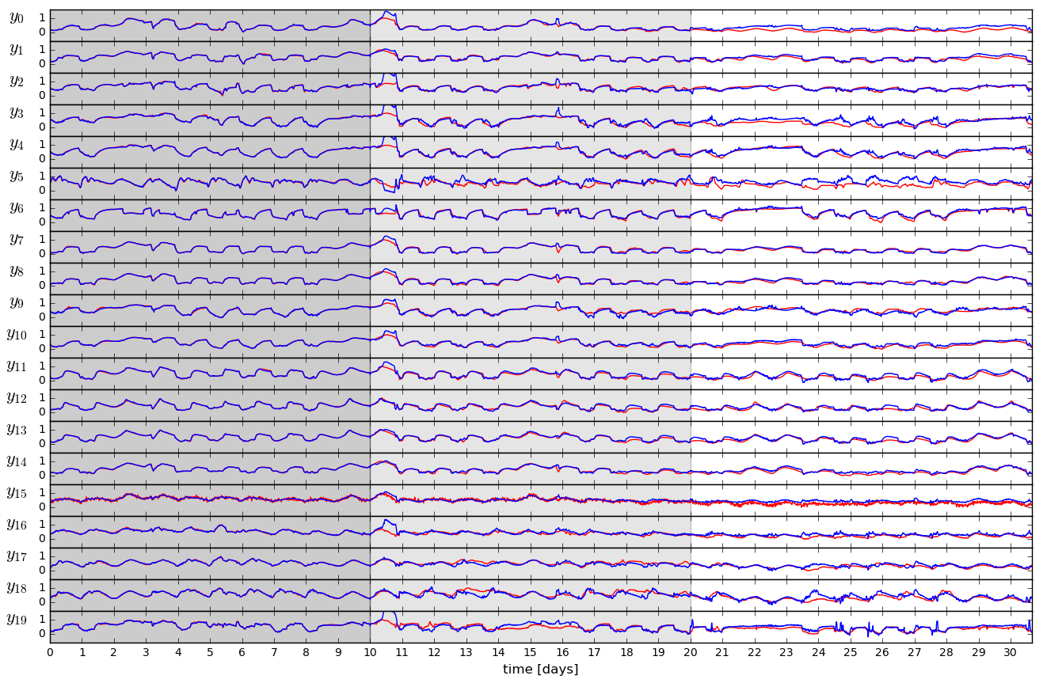
Open-loop Trajectories of Neural Model

Slide 20
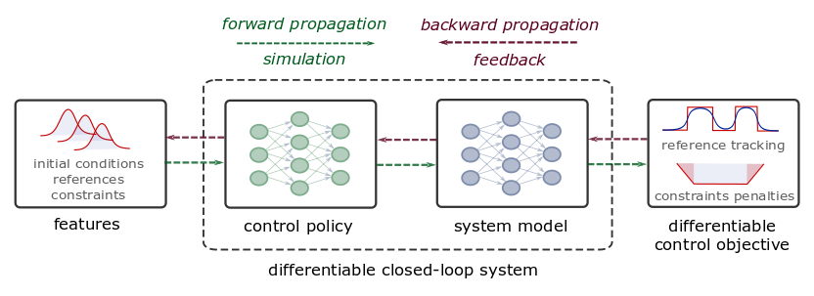
Differentiable Predictive Control
Constrained Model-based Policy Optimization for Parametric Optimal Control
Jan Drgona, Aaron Tuor, Draguna Vrabie, Learning Constrained Adaptive Differentiable Predictive Control Policies With Guarantees, 2021,
https://arxiv.org/abs/2004.11184
Jan Drgona, et al., Differentiable Predictive Control: An MPC Alternative for Unknown Nonlinear Systems using Constrained Deep Learning, Journal of Process Control, 2022, https://arxiv.org/abs/2011.03699

Slide 21
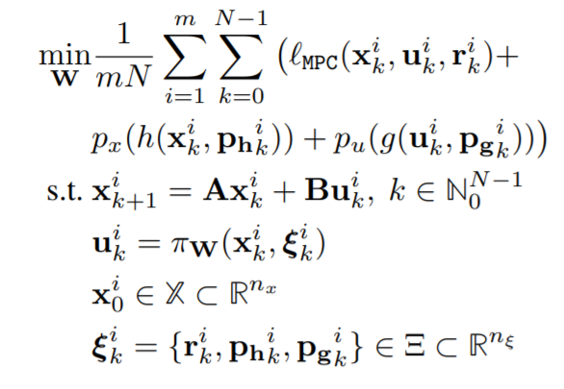
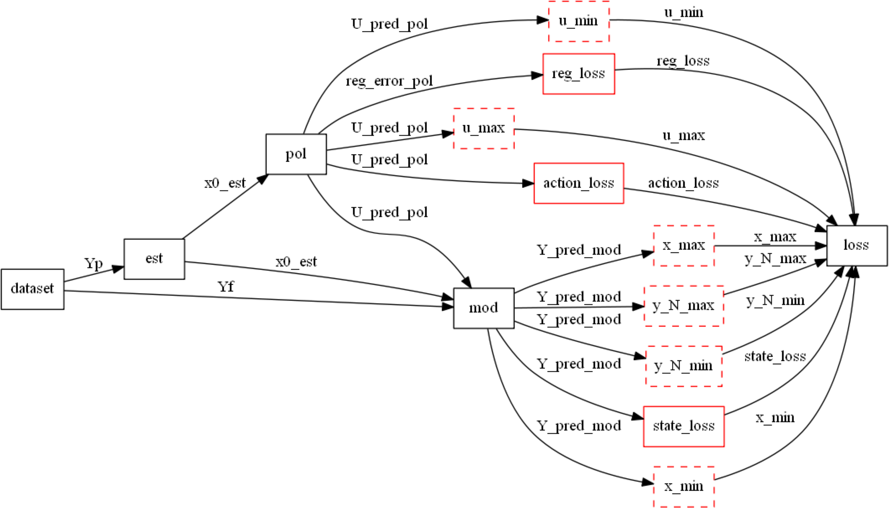
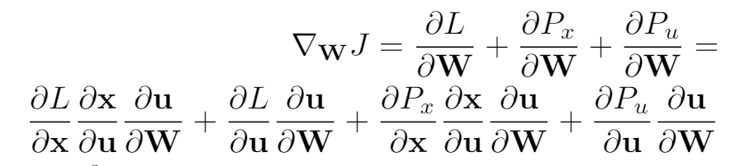
Differentiable Computational Graphs and Model-based Policy Gradients
Differentiate the computational graph to train the policies using state-of-the-art deep learning practice.

Slide 22
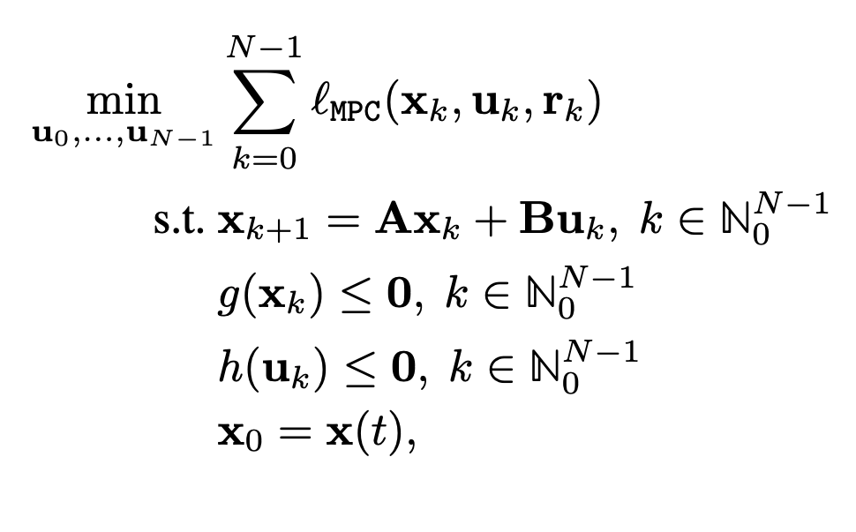
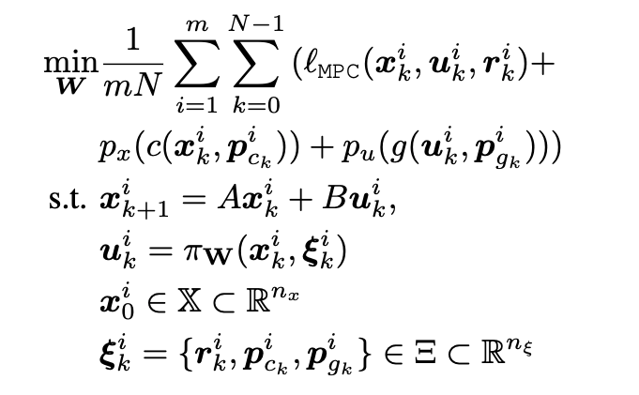
Differentiable Predictive Control (DPC)
From data to optimized explicit predictive control policy
MPC
DPC
Cost:
Model:
Constraints:
Online optimization
Optimize for control actions
Implicit solver-based control policy
Offline optimization
Optimize for control policy parameters
Explicit neural control policy
Jan Drgona, et al., Differentiable Predictive Control: An MPC Alternative for Unknown Nonlinear Systems using Constrained Deep Learning, Journal of Process Control, 2022

Slide 23


Differentiable Computational Graphs and Model-based Policy Gradients
Constructing differentiable computational graph: implementing parametric MPC problem in Pytorch.
https://pytorch.org/
https://github.com/pnnl/neuromancer

Slide 24
Differentiable Computational Graphs and Model-based Policy Gradients
Forward pass: evaluate graph components (policy, model, constraints, objective terms) to compute structured learning loss function.
https://github.com/pnnl/neuromancer

Slide 25
Differentiable Computational Graphs and Model-based Policy Gradients
Forward pass: evaluate graph components (policy, model, constraints, objective terms) to compute structured learning loss function.
https://github.com/pnnl/neuromancer

Slide 26
Differentiable Computational Graphs and Model-based Policy Gradients
Forward pass: evaluate graph components (policy, model, constraints, objective terms) to compute structured learning loss function.
https://github.com/pnnl/neuromancer

Slide 27
Differentiable Computational Graphs and Model-based Policy Gradients
Forward pass: evaluate graph components (policy, model, constraints, objective terms) to compute structured learning loss function.
https://github.com/pnnl/neuromancer

Slide 28
Differentiable Computational Graphs and Model-based Policy Gradients
Forward pass: evaluate graph components (policy, model, constraints, objective terms) to compute structured learning loss function.
https://github.com/pnnl/neuromancer

Slide 29
Differentiable Computational Graphs and Model-based Policy Gradients
Forward pass: evaluate graph components (policy, model, constraints, objective terms) to compute structured learning loss function.
https://github.com/pnnl/neuromancer

Slide 30
Differentiable Computational Graphs and Model-based Policy Gradients
Backward pass: Differentiate the computational graph to train the policies using state-of-the-art deep learning tools.
https://github.com/pnnl/neuromancer

Slide 31
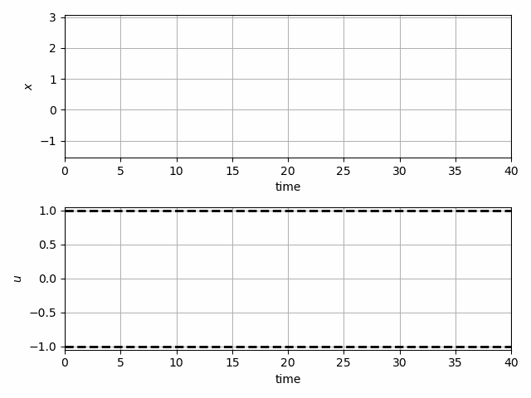
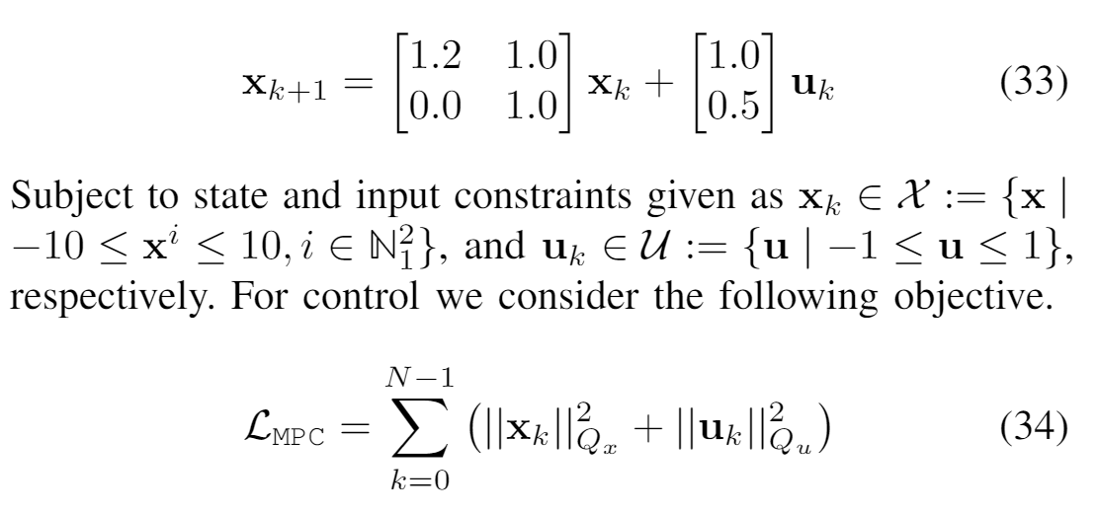
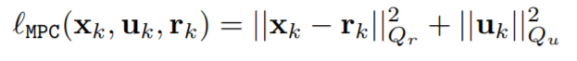
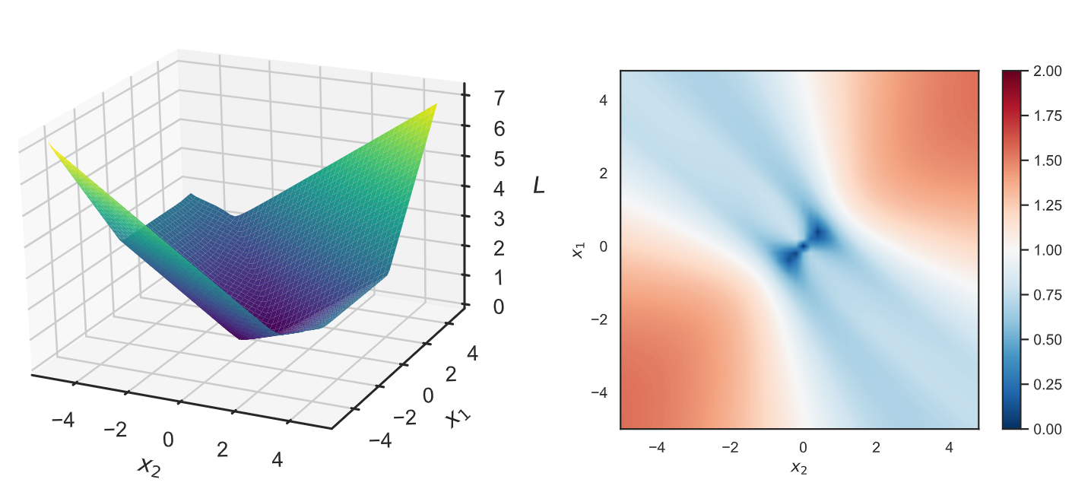
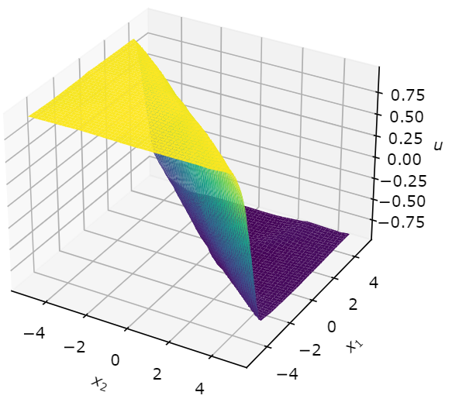
Learning to Stabilize Unstable System
Problem setup:
DPC formulation:
Jan Drgona, Aaron Tuor, Draguna Vrabie, Learning Constrained Adaptive Differentiable Predictive Control Policies With Guarantees, https://arxiv.org/abs/2004.11184

Slide 32
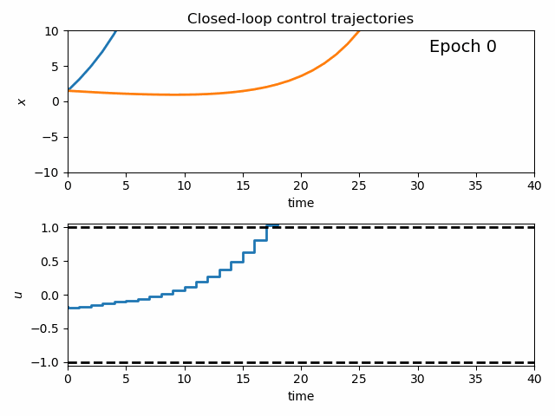
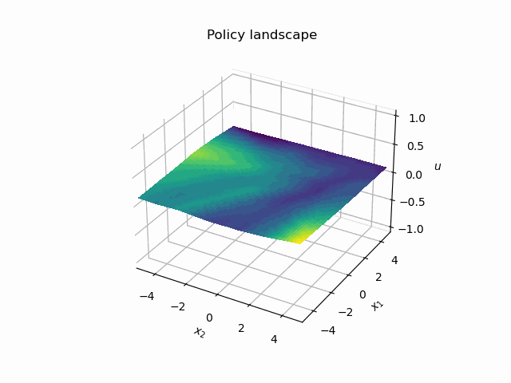
Dynamics of DPC Control Policy Learning
1341 learning parameters, 48.2 seconds offline training time on a CPU with 200 epochs.
Jan Drgona, Aaron Tuor, Draguna Vrabie, Learning Constrained Adaptive Differentiable Predictive Control Policies With Guarantees, https://arxiv.org/abs/2004.11184

Slide 33
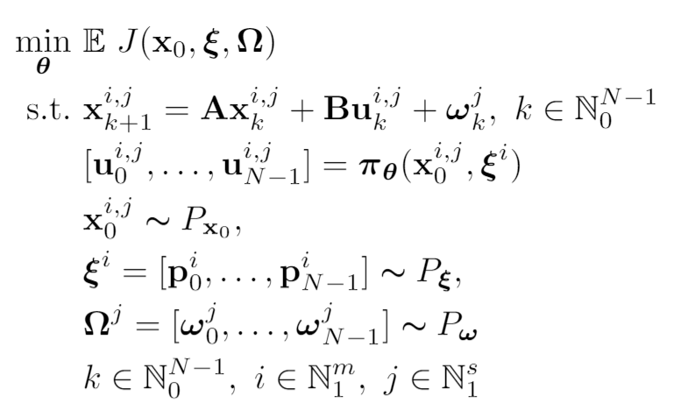
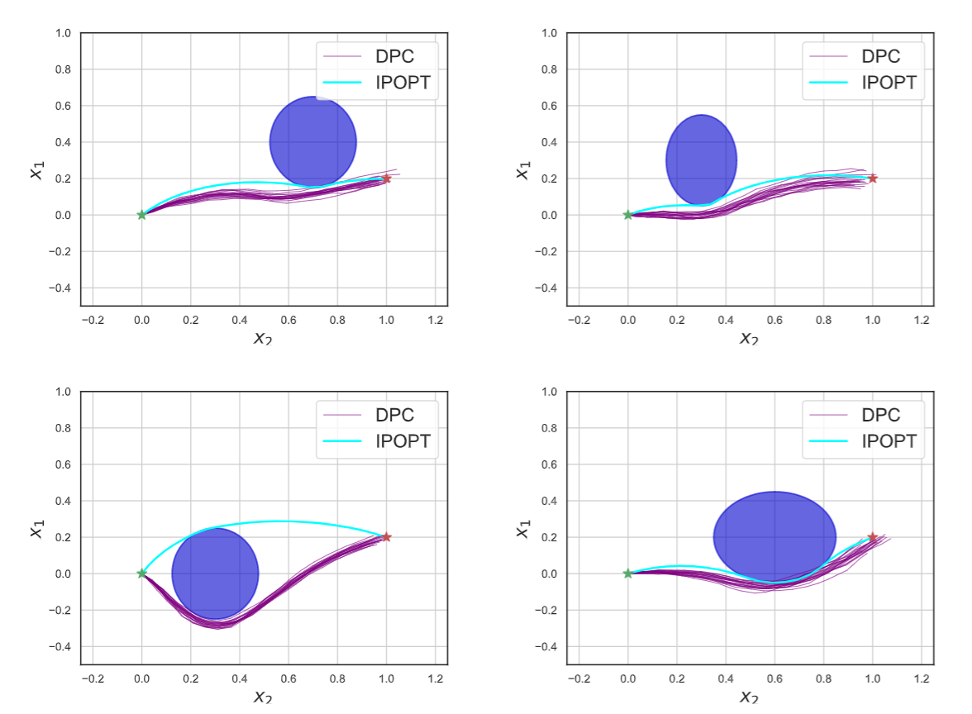
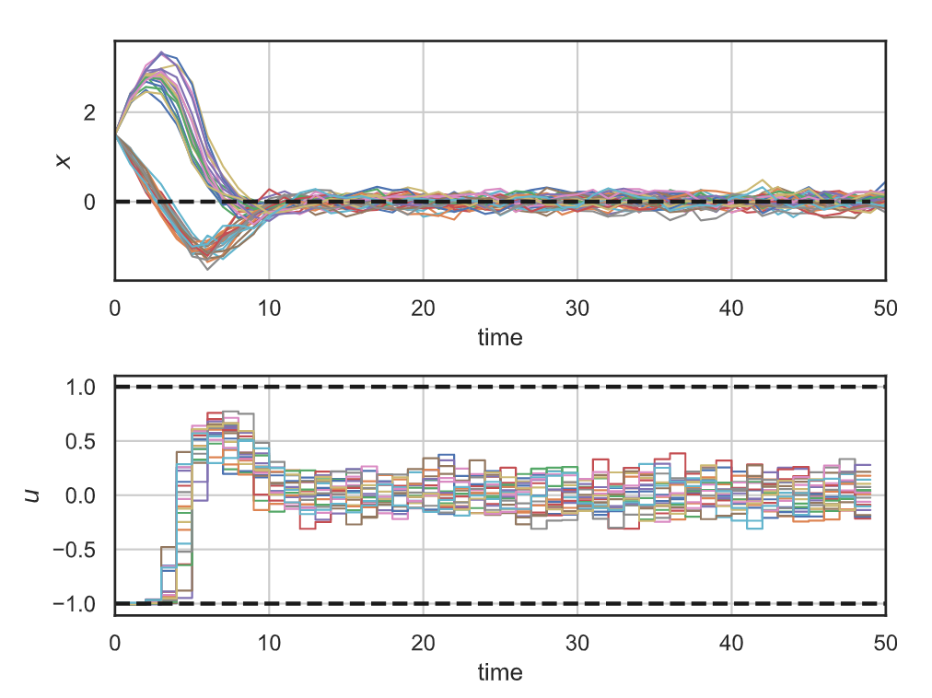
Stochastic Differentiable Predictive Control
Stochastic obstacle avoidance
Stochastic
formulation
Parameters
Uncertainties
Robustness
to state noise
Jan Drgona, Sayak Mukherjee, Aaron Tuor, Mahantesh Halappanavar, Draguna Vrabie, Learning Stochastic Parametric Differentiable Predictive Control Policies, arXiv:2203.01447, to appear at IFAC ROCOND 2022

Slide 34
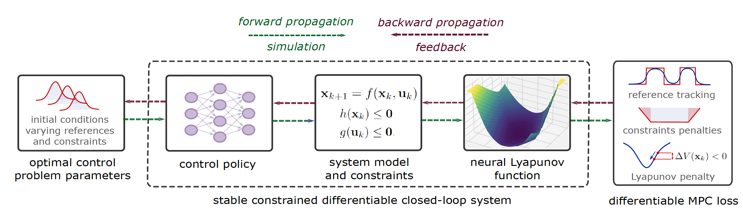
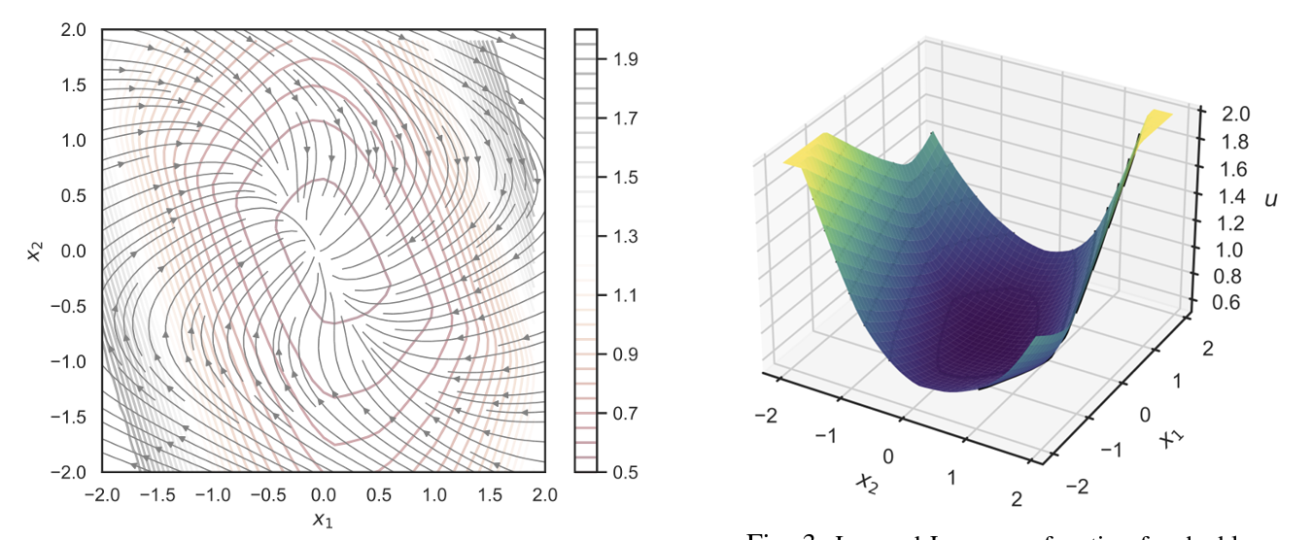
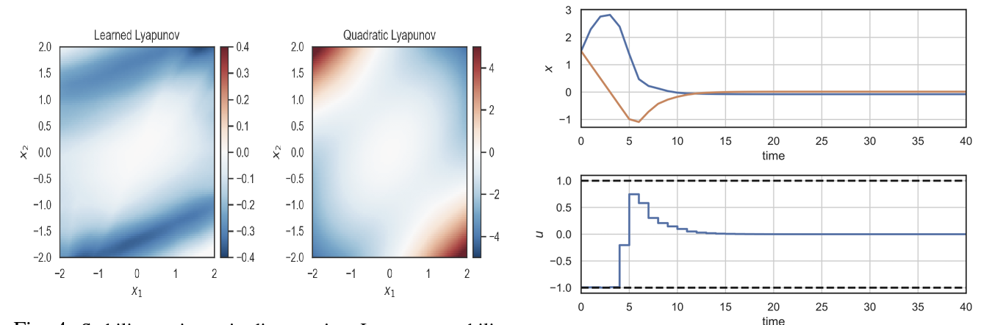
Learning Stable Policies via Neural Lyapunov Differentiable Predictive Control
Sayak Mukherjee, Ján Drgoňa, Aaron Tuor, Mahantesh Halappanavar, Draguna Vrabie, Neural Lyapunov Differentiable Predictive Control, arXiv:2205.10728, 2022

Slide 35
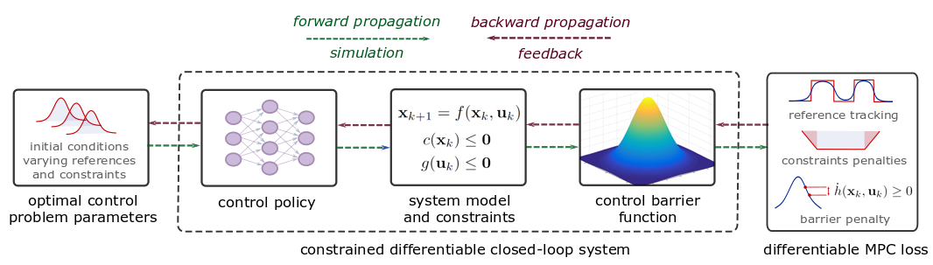
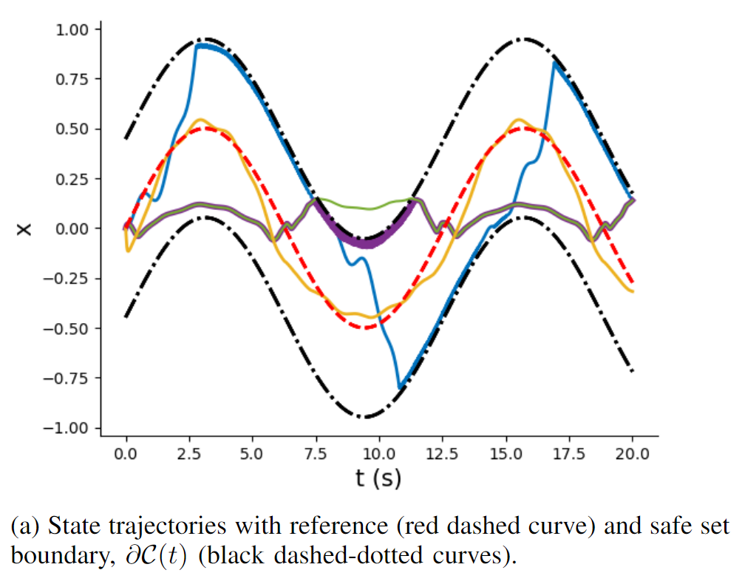
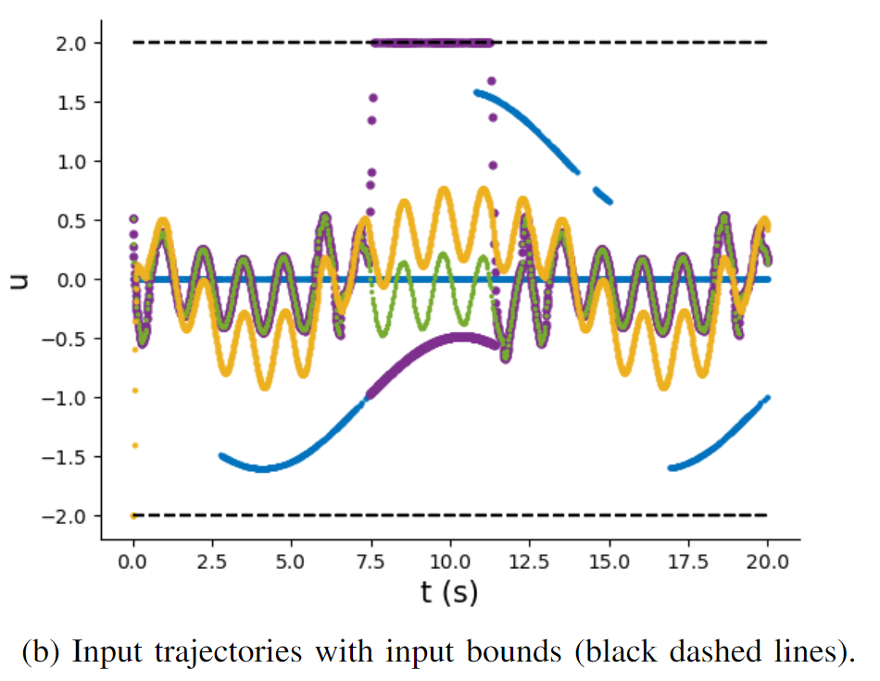
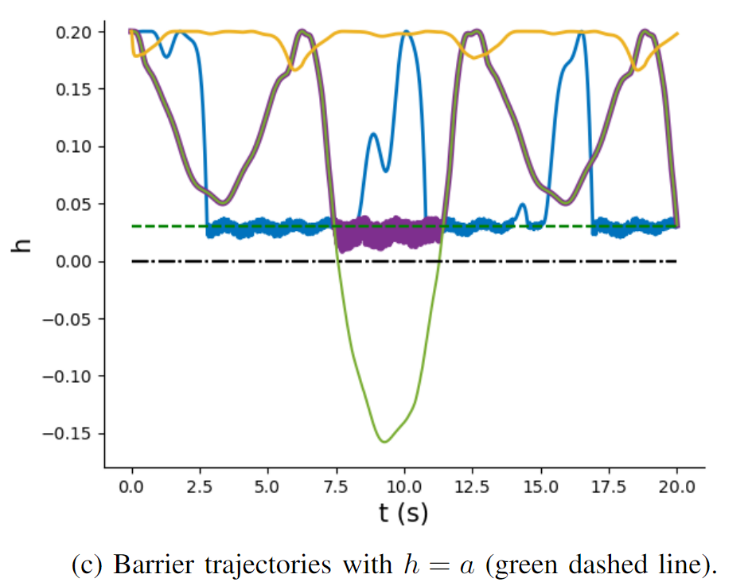
Learning Safe Policies via Differentiable Predictive Control with Control Barrier Functions
Wenceslao Shaw Cortez, et al., Differentiable Predictive Control with Safety Guarantees: A Control Barrier Function Approach, arXiv:2208.02319, 2022

Slide 36


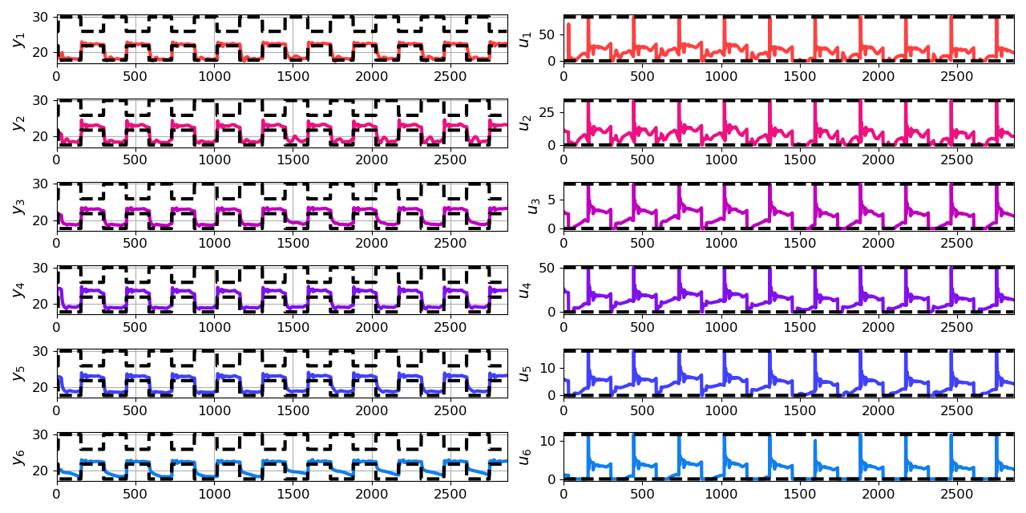
Economic Differentiable Predictive Control of Building Energy System
Architectures
Neural state space dynamics model
MLP control policy architecture
Domain-aware constraints
Results
Multi-input multi-output system dynamics
Dynamic economic control objective
Parametric constraints
Jan Drgona, Aaron Tuor, Elliott Skomski, Soumya Vasisht, Draguna Vrabie, Deep Learning Explicit Differentiable Predictive Control Laws for Buildings, IFAC NMPC 2021

Slide 37


Dynamics-Aware Economic Redispatch via Differentiable Predictive Control
Problem: Current redispatch processes do not incorporate system dynamics concerns. Incorporating dynamics in redispatch is too complex and/or time-consuming
Architectures
Koopman dynamics model
CNN control policy
Solution: Machine-learning based dynamics-aware redispatch. Learn system dynamics for faster assessment.
Results
5 orders of magnitude speed-up
Minimal loss in solution quality
Ethan King, Ján Drgoňa, Aaron Tuor, Shrirang Abhyankar, Craig Bakker, Arnab Bhattacharya, Draguna Vrabie, Koopman-based Differentiable Predictive Control for the Dynamics-Aware Economic Dispatch Problem, The 2022 American Control Conference

Slide 38
Embedded Implementation of DPC
Flexy-Air system sketch with Raspberry-Pi controller
Performance comparison: reference (red dashed), position controlled with PI controller (green), explicit model predictive control (purple), constrained differentiable predictive control (blue) and constraints (black-dashed). Bottom figures show the fan speed controls
Jan Drgona, Karol Kis, Aaron Tuor, Draguna Vrabie, Martin Klauco, Differentiable Predictive Control: An MPC Alternative for Unknown Nonlinear Systems using Constrained Deep Learning; Journal of Process Control, 2022

Slide 39

Conclusion
SciML Methods
Differentiable programming
Parametric programming
Constrained optimization
Dynamical modeling and control
Ongoing work
Constrained optimization solvers
Graph neural networks (GNNs)
Uncertainty Quantification (UQ)
Long-Term Vision
Causal discovery, dynamical coupling, sensitivity, structure, and stability analysis, machine reasoning
Solving large-scale parametric constrained optimization problems
https://github.com/pnnl/neuromancer
https://github.com/pnnl/slim

Slide 40














Acknowledgements
Aaron Tuor
James Koch
Zhao Chen
Stefan Dernbach
Christian M. Legaard
Ethan King
Sayak Mukherjee
Wenceslao Shaw Cortez
Soumya Vasisht
Shrirang Abhyankar
Mahantesh Halappanavar
Draguna Vrabie

